Slide 1
$, $$, $$$
API testing Edition
Which QA tools are worth it at their respective price points?

Slide 2
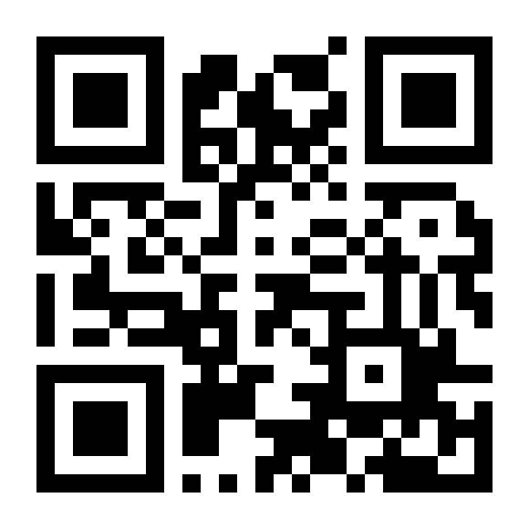
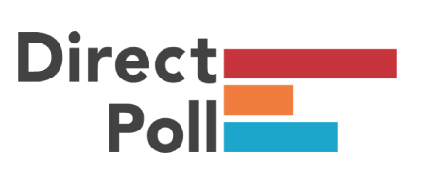
Let’s get to know one another
http://etc.ch/38Xg

Slide 3
Agenda;
Poll
Introduction
What’s an API
Let’s get some jargon out of the way
How do I test an API
$ - Swagger / BASH / HTTPS / Powershell
$$ - Postman / Fiddler
$$$ - Soap UI / Katalon

Slide 4
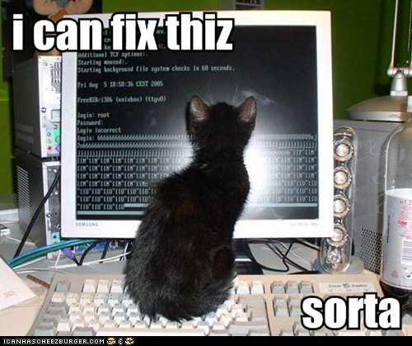
Introduction(victorla);
Hi I’m Victor;

Slide 5
Import Disclaimer ;
I am not authorized to speak on behalf of Parametric or Eaton Vance and my opinions are my own.
// I.E Don’t take financial advice from me :)

Slide 6
What’s an API;
What’s an API?
“In computer programming, an application programming interface (API) is a set of subroutine definitions, protocols, and tools for building application software. In general terms, it is a set of clearly defined methods of communication between various software components” (Links and emphasis original to Wikipedia)
In English please?
A collection of “endPoints” or services
Exposes functionality for internal or external use

Slide 7
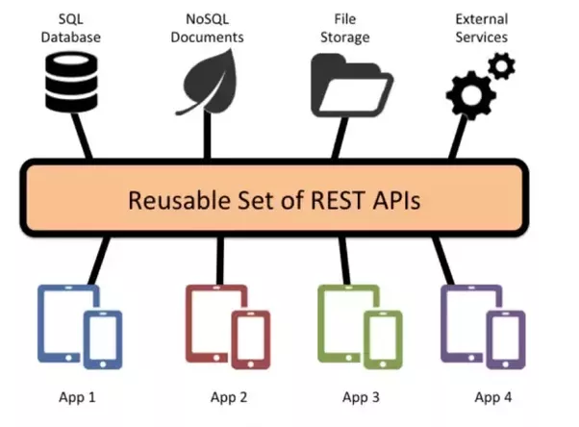

Slide 8
Jargon(Rest);
What is ReST? - Representational State Transfer
“Representational state transfer or “REST” is the software architectural style designed for distributed systems and, particularly, the World Wide Web”
Rest Properties:
Stateless - Each data request and response pair is treated as completely independent from prior and future requests. These states are “in transition” when one or more requests are outstanding.
Client-server separation - These two are completely separate, enabling them to be developed and replaced independent of each other.
Uniform Interface
Cacheable - Everything on the Web can be cached, so responses must clearly define whether or not they are cacheable, avoiding either inappropriate caching or caching of old information.
Layered systems - Intermediary servers must be available to make the system more scalable.

Slide 9
Jargon(SOAP);
What is SOAP - Simple Object Access Protocol
SOAP provides the Messaging Protocol layer of a web services protocol stack for web services. It is an XML-based protocol consisting of three parts:
an envelope, which defines the message structure^{[1]} and how to process it
a set of encoding rules for expressing instances of application-defined data types
a convention for representing procedure calls and responses
SOAP has three major characteristics:
extensibility (security and WS-Addressing are among the extensions under development)
neutrality (SOAP can operate over any protocol such as HTTP, SMTP, TCP, UDP, or JMS)
independence (SOAP allows for any programming model)

Slide 10
Jargon(HTTP);
What’s HTTP
HTTP means HyperText Transfer Protocol. HTTP is the underlying protocol used by the World Wide Web and this protocol defines how messages are formatted and transmitted

Slide 11
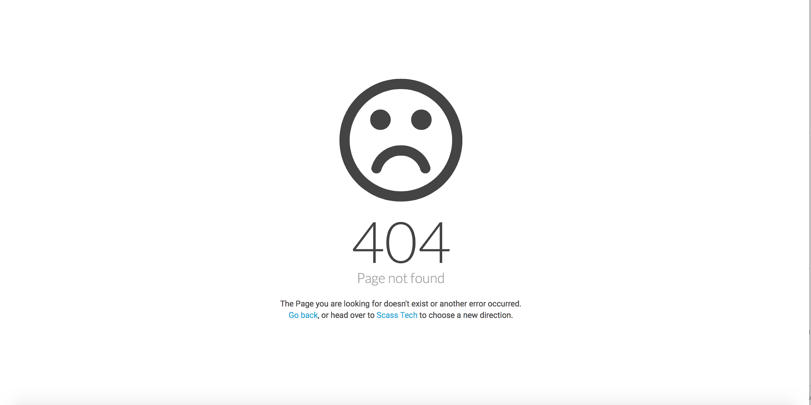

Slide 12
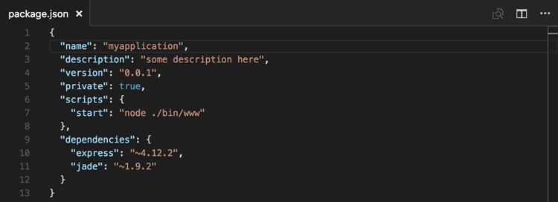
Jargon(json)
Json- In computing, JavaScript Object Notation or JSON is an open-standard file format that uses human-readable text to transmit data objects consisting of attribute–value pairs and array data types.

Slide 13
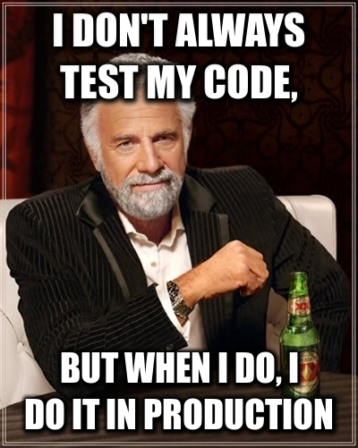
HOw do i test an API?
Request Method:
POST - to add data, like to a message board
GET - to retrieve data, but without altering it, from a particular URL
PUT - to save an update to the unified resource identifiers (URI)
DELETE - to remove a specified resource
PATCH - to make a change in a request
We get it? Let’s GO!

Slide 14
$ - Swagger
https://petstore.swagger.io/
Swagger is an open source software framework backed by a large ecosystem of tools that helps developers design, build, document, and consume RESTful Web services

Slide 15
$ - Bash it!
Let’s get into it!

Slide 16
$ - HTTPS
https://petstore.swagger.io/v2/pet/findByStatus?status=available

Slide 17
$ | $$$ - Postman

Slide 18
$ | $$$ Soap UI
Back to the Demos

Slide 19
Things to look for in Good API Tooling ;
Feature Rich:
Price:
Most Tools have a free version and a Paid version
Intuitive :
Easy to use and easy to set up
Community Support
CI/CD - Automation
API | CD/CI | Monitoring | Documentation
Windows/MAC/Linux | Repeatability | Cloud / Self Host | Logging

Slide 20
Thank(you);
Questions?

Slide 21
References
https://www.soapui.org/learn/api/what-is-a-rest-api.html
https://petstore.swagger.io/
https://www.soapui.org/learn/functional-testing/api-testing-101.html
https://www.katalon.com/resources-center/tutorials/introduction-api-testing/

